Slide 1
Programmable HPC Network Fabrics for Adaptive Computing
Supercomputing 2017
Dr. Venkat Dasari
Army Research Laboratory
Approved for public release

Slide 2
Motivation
Rapid adoption of heterogeneous computing platforms require hardware independent abstraction layer to connect data to the computing platforms.
Adaptive computing architectures are highly needed in tactical environment
Network is also a computer.
Approved for public release

Slide 3
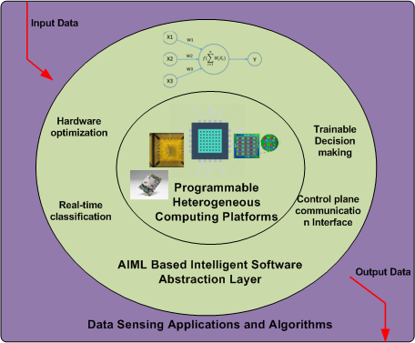
Adaptive Computing Overview
Heterogeneous computing platforms
Hardware agnostic AIML abstractions
Programmable Networks
Approved for public release

Slide 4
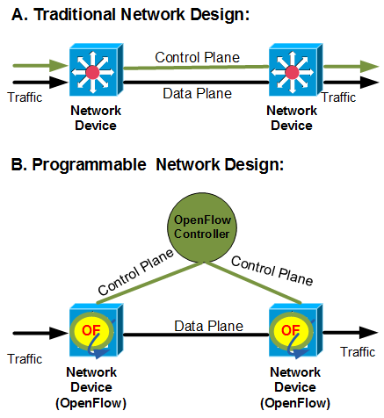
Classical vs Programmable Networks
Control plane is externally placed in programmable networks.
Networks are application aware and vice versa
Unified forwarding and Security Policy enforcement
Software driven network intelligence and vendor agnostic
Approved for public release

Slide 5
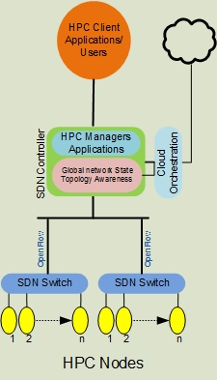
Design Overview
MPI/OpenFlow Interaction Schema extended from Takahashi, et al. model
Global view of HPC programmable network fabric
Approved for public release
Notes:
Add more descriptive labels

Slide 6
Approach
  Modify OpenFlow switch and controller
  Modify Ryu, build and install with additional MPI fields
  Modify Open VSwitch
  Modify Loxigen, build OpenFlow Dissector
  Install kernel modules and binaries for testing with Mininet
Approved for public release

Slide 7
Proposed MPI Data Structures for OpenFlow
 | CPU load | RAM load | Bandwidth | Latency
Description | Current total CPU load % on node | Current total RAM load % on node | Current % of total throughput available | Round trip time between switch and node
Field Name | mpi_cload | mpi_rload | mpi_bwidth | mpi_ping
New data structures proposed to create interaction between OpenFlow and MPI
Approved for public release

Slide 8
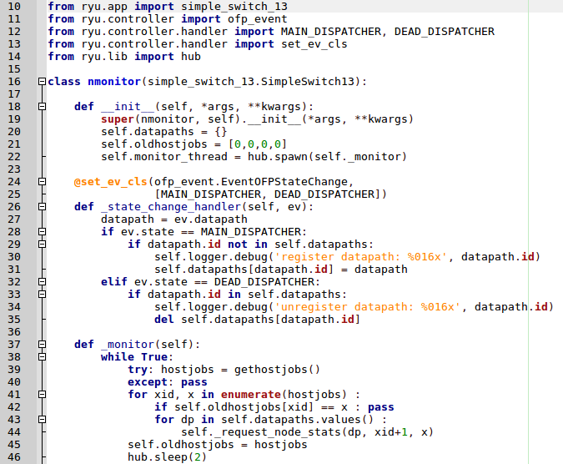
Code Snippet
Programmable OpenFlow functions
Approved for public release

Slide 9
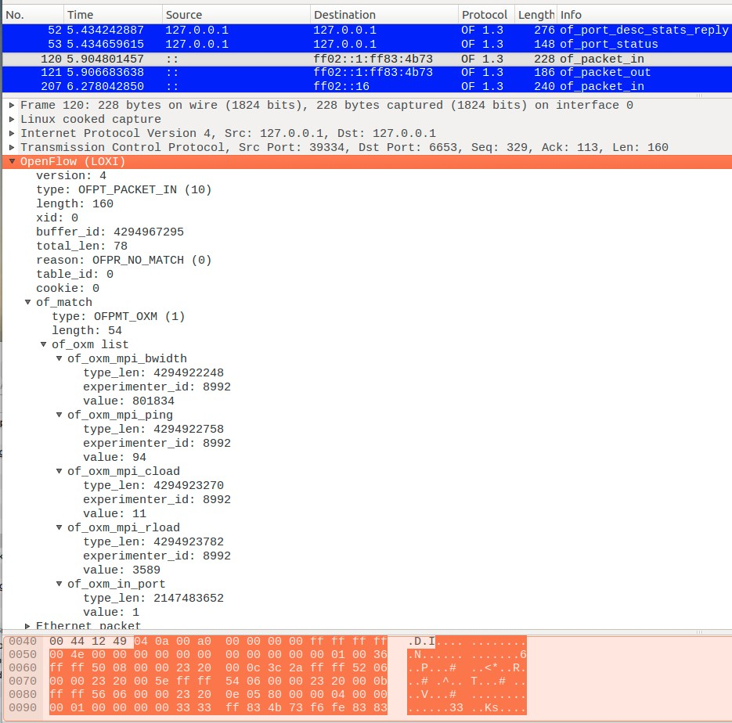
Experimenter labels captured
Approved for public release

Slide 10
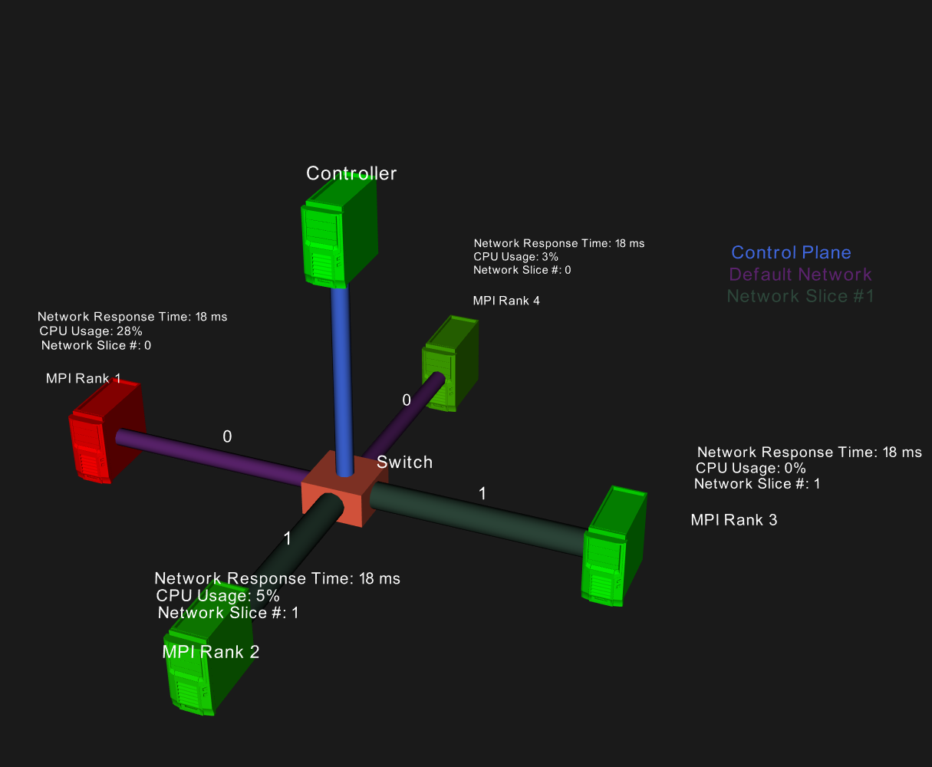
Adaptive Computing Cluster
Real-time visualization of programmable network fabric for adaptive computing
Approved for public release

Slide 11
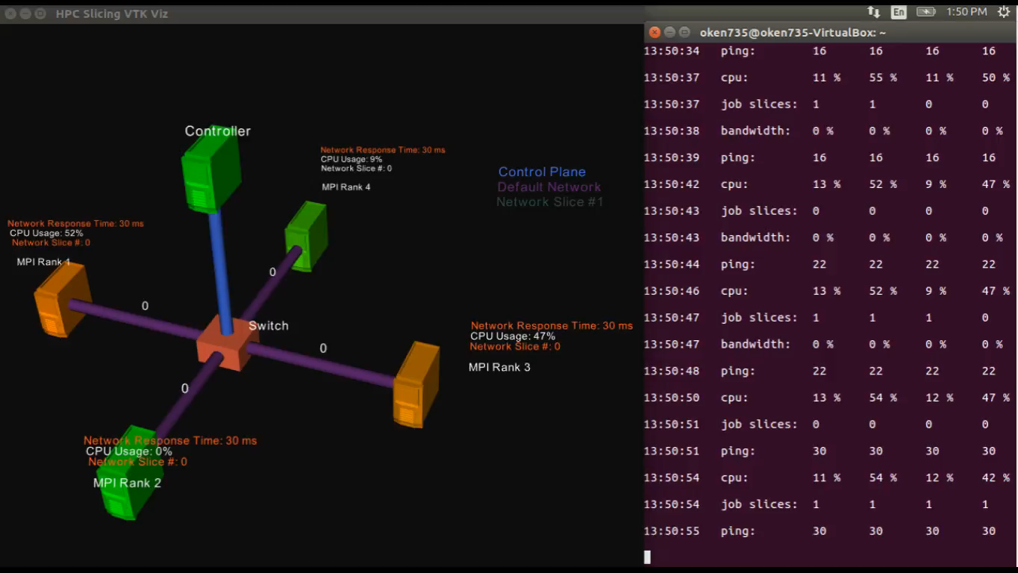
DEMO
Approved for public release

